Slide 1
Indian market for AWS

Slide 2


Slide 3
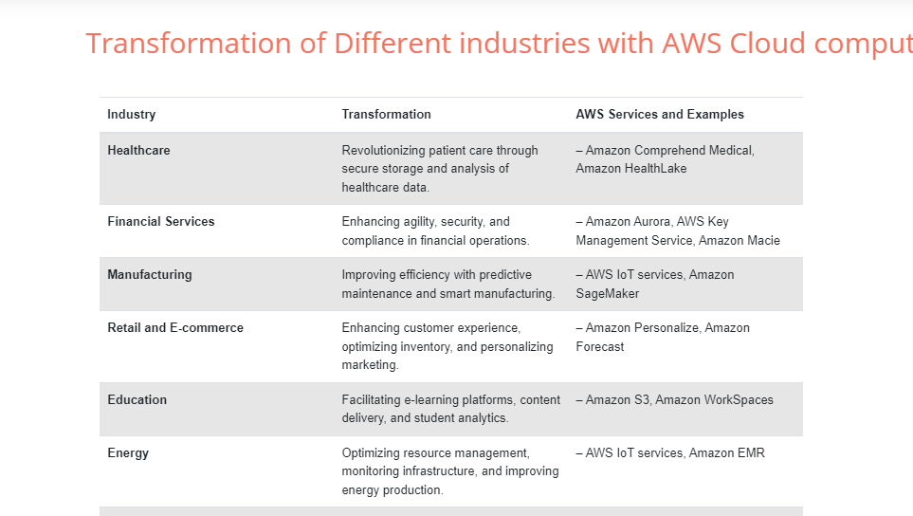
AWS Services in different sectors

Slide 4
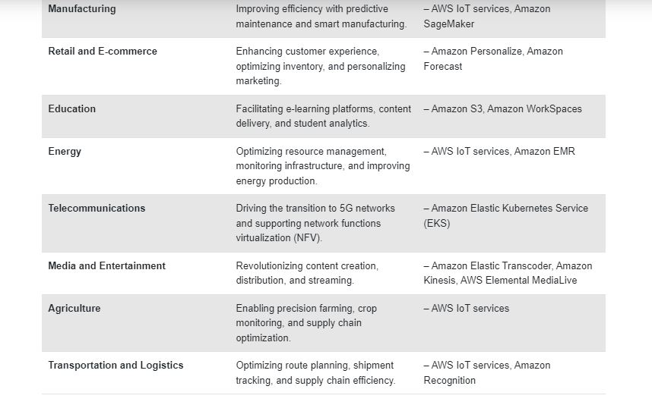
AWS services in different sectors

Slide 5
Over all AWS market in INDIA
The ecommerce market in India has grown rapidly over the last 4-5 years. In 2018, the market size was $38.5 billion, which grew to $69.2 billion by 2022—a compound annual growth rate (CAGR) of 22.5 percent.
Amazon has committed to investing an additional $15 billion in India by 2030—taking the total up to $26 billion, across all its businesses.
Aws created over 1.3 million direct and indirect jobs in India. Of its total investment, AWS planned announcement of $12.7 billion by 2030 is expected to contribute $23.3 billion to India’s GDP by 2030.
Amazon Web Services (AWS) WILL invest Rs 1.05 trillion into cloud infrastructure in India by 2030 as it looks to meet growing customer demand for cloud services in the country

Slide 6
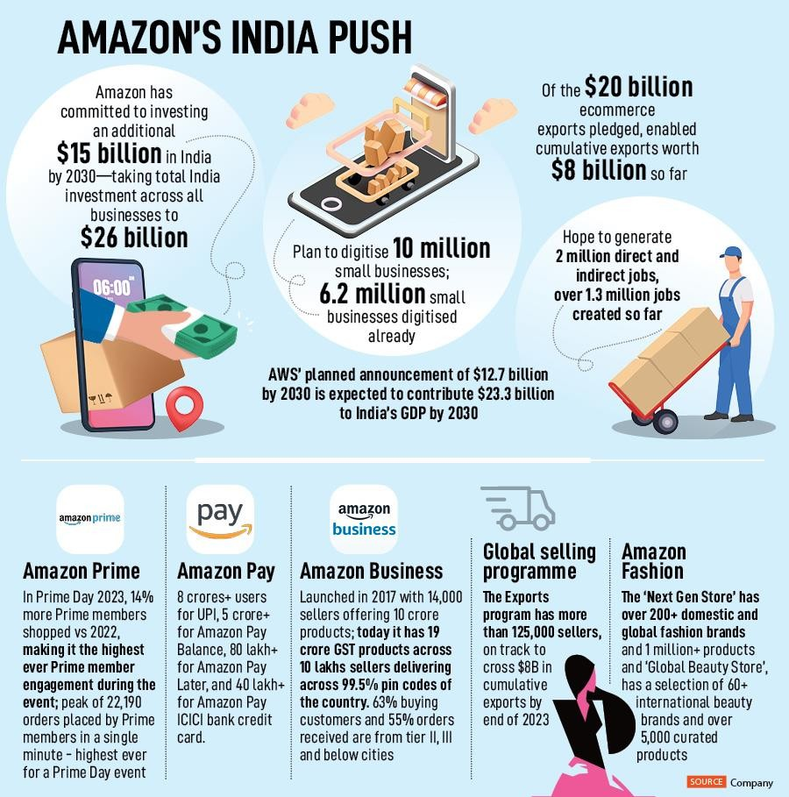
AWS-Indian market

Slide 7
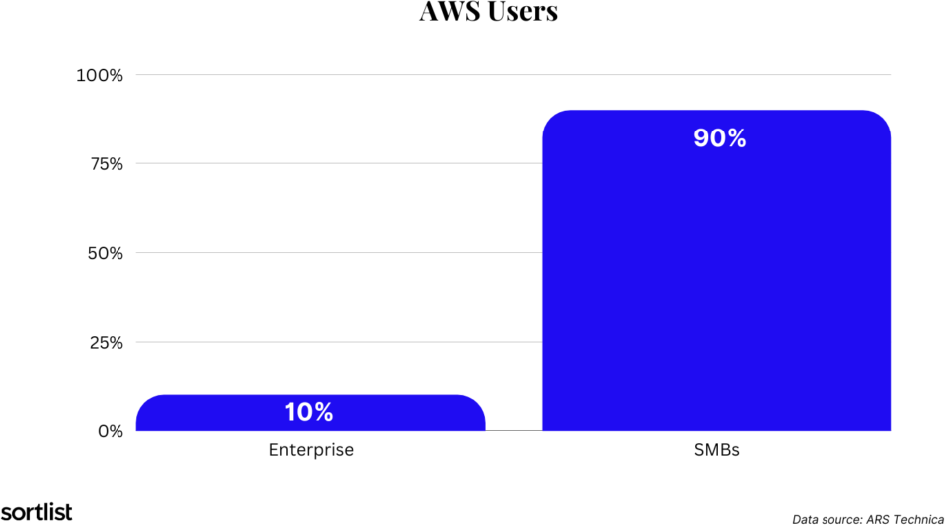
AWS-Users across the India

Slide 8
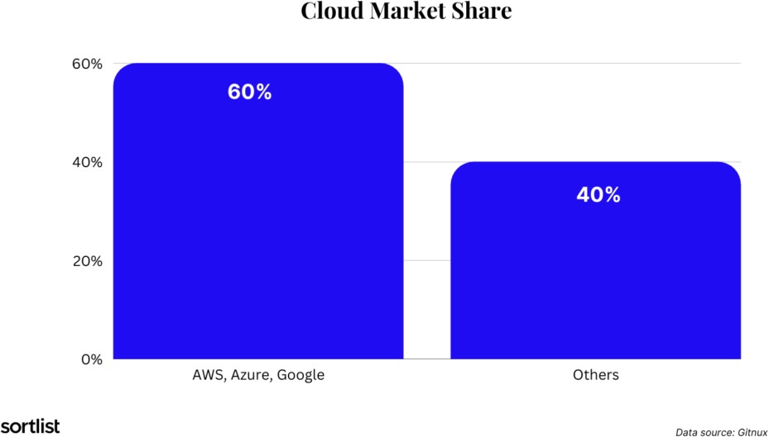
Cloud-market share with other providers

Slide 9
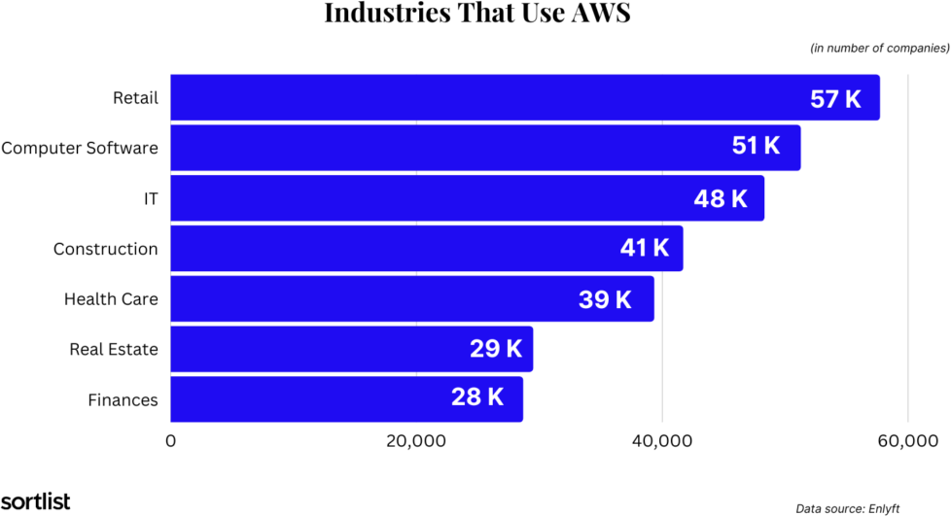
Different sectors of India using AWS services

Slide 10
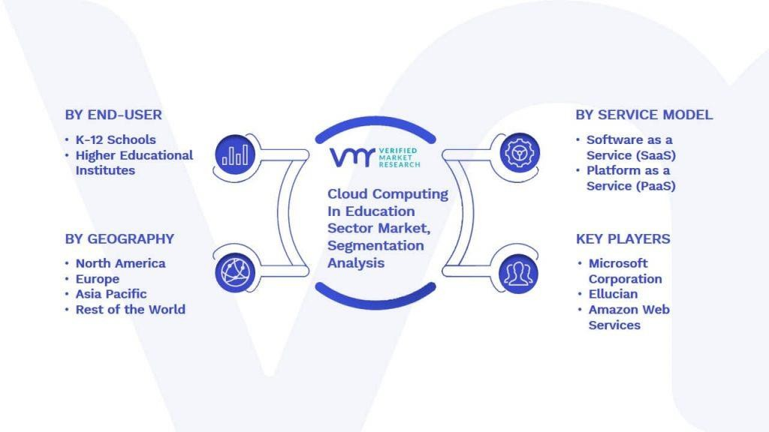
AWS-Education sector
Cloud Computing In Education Sector Market size was valued at USD 23.81 Billion in 2021 and is projected to reach USD 173.62 Billion by 2030, growing at a CAGR of 24.70% from 2022 to 2030.

Slide 11
AWS in Corporate sector
The cloud computing market is expected to reach USD 2321.1 Billion by 2032, reaching a registered CAGR of 16% from 2023 to 2032. Various factors leading to its exponential growth are innovations like AL, ML, SaaS, and data security and privacy.
Almost 60% of all corporate data is stored in Cloud

Slide 12
AWS-MSME(Micro Small and Medium Enterprise) Sector-India's largest online e-commerce platform.
AWS has helped MSMEs use cloud technologies to seize opportunities in
the digital economy and transform their business models.
MSME registered businesses could make bulk purchases from Amazon Business and offers discounts and cashback for placing bulk orders.
AWS has helped MSMEs use cloud technologies to seize opportunities in the digital economy and transform their business models. For example, AWS Activate helps startups at the earliest stages looking to accelerate and grow their business
Amazon Business also offers discounts and cashback for placing bulk orders.
Business owners can save up to 28% from GST input tax credit

Slide 13

AWS-Health care Sector
The healthcare sector is embracing cloud, with investment set to grow 16% a year from ₹118.3 billion in 2022 to ₹208.5 billion in 2026 across the nine countries.
However, cloud in healthcare has the second lowest investment in cloud compared with six select sectors and the second lowest growth in investment over the next five year
AWS has partnered with customers and health technology companies to create purpose-built services and solutions, such as AWS HealthLake, AWS HealthOmics, Amazon Comprehend Medical, becoming the industry standard for healthcare technology innovation

Slide 14
Indian potential for AWS
AWS will invest Rs 1.05 trillion into cloud infrastructure in IIndia by 2030 as it looks to meet growing customer demand for cloud services in the country.
Amazon's cloud computing unit on Thursday said that the planned investment in data centre infrastructure in India will support an estimated average of 1,31,700 full-time equivalent (FTE) jobs in Indian businesses each year.

Slide 15
Data Dice Organization as a cost optmization
According to the revenue plan of AWS maximum organizations will develop and deploy their applications in different sectors by using upto 10% of the total cost of AWS.
Where as organizations like “DATA-DICE” will develop and deploy the applications in different sectors by implementing cloud technologies along with early detection and early prevention with some tools and with low cost optimization methods.

Slide 16

Thank you

